Slide 1
Title II A Private School Consultation
August 14, 2018

Slide 2
Agenda
Welcome and Attendance
Overview of the Process
Guidance
Needs Assessment
How to Draw Funds
Availability of Funds

Slide 3
Welcome
Thank you for joining us
Please identify
  who you are,
  what school you are from,
  what your job title is

Slide 4
Title II Part A
Supporting Effective Instruction
Purpose of Funds:
increase student achievement
improve the quality and effectiveness of teachers, principals, and other school leaders;
provide low-income and minority students greater access to effective teachers, principals, and other school leaders

Slide 5
Purpose of Funds for
Private Schools
Provide Private School Educators with equitable services for Professional Development in comparison to public schools.

Slide 6
Process
Indicate Interest (annual survey)
Participate in the Consultation
Submit a Needs Assessment
Request to Draw Funds

Slide 7
Process – Consultation
Schools participate in the consultation meeting (step 2).
  Participation is met through:
    Participation in State sponsored activities and/or
    Participation in activities designed by Private Schools identified in their Needs Assessment

Slide 8
Process – Needs Assessment
Schools submit their Needs Assessment Worksheet to the SEA (step 3)
    Due: August 24, 2018
    Email to: Title2Privateschool@notes.k12.hi.us

Slide 9
Process How to Draw Funds
Complete the Request for Expenditure of Title II A Funds (OHR, PS1) (step 4)
Submit to Hawaii Department of Education (HIDOE) at least 30 days prior to activity or travel
Submit Requests to:
  Email: title2privateschool@notes.k12.hi.us or
  Mail to:
      Department of Education
      Office of Talent Management
      650 Iwilei Road, Suite 320
      Honolulu, HI 96817
      Attn: Educator Quality Section – Private School Participation

Slide 10
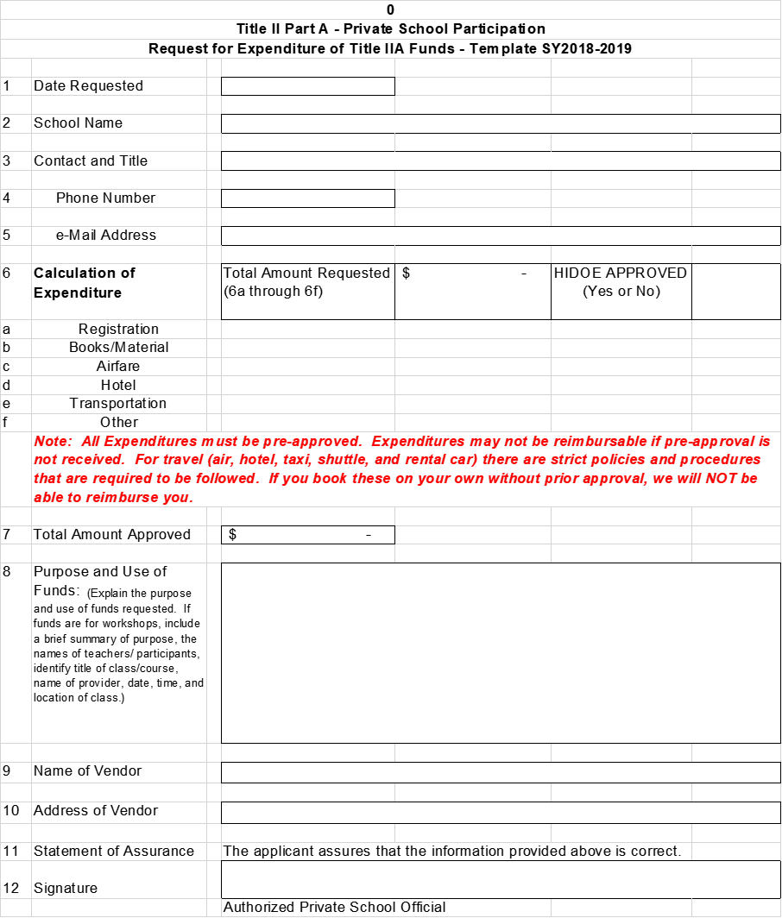

Slide 11
How to Draw Funds Continued
Notification of Approval will be sent to the schools
After the services/activities have been provided, documentation needs to be submitted to HIDOE
Note: All Expenditures must be pre-approved.
Expenditures may not be reimbursable if pre-approval is not received.
For travel (air, hotel, taxi, shuttle, and rental car) there are strict policies and procedures that are required to be followed. If you book these on your own without prior approval, we will NOT be able to reimburse you.

Slide 12
How to Draw Funds (continued)
HIDOE will process the request and make payment directly to the provider

Slide 13
Guidance
Funds are set-aside for private schools to draw from for services that the HIDOE will provide.
Funds can only be used for allowable professional development activities
  Improve the knowledge of teacher, principals and other educational personnel in content subjects
  Improve instructional strategies, methods and skills
  Integrating technology to the curricula
  Methods to improve student behavior
  Leadership training for Principals and Superintendents
  Use of data and assessments to improve instruction

Slide 14
Guidance - continued
Services are for teachers, principals, and other school leaders (can not be used for students and non-educator personnel)

Slide 15
Guidance - Travel
Hawaii Administrative Rule HAR §3-10-6
  Requires that the lowest fare is purchased and
  Any changes due to personal travel shall be the responsibility of the traveler
  In general Rental Cars are not allowed
Hawaii Department of Education Out of State Travel Guidelines
  Travel departure time may not be in excess of 30 hours prior to the start of business and/or end of business function.

Slide 19
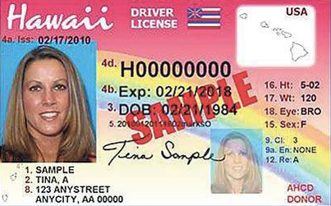
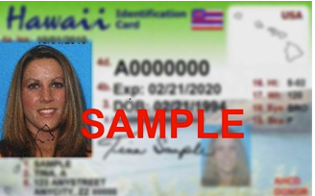

Slide 21
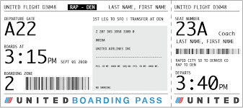
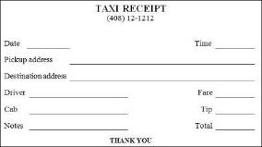
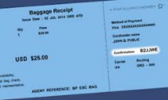
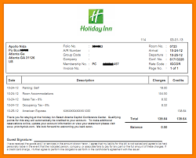
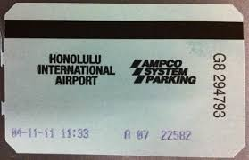
Boarding Passes
Taxi receipt
Baggage receipt
Hotel Receipt
Parking Receipt
Mail to :
OHR/PDB/Educator Quality
650 Iwilei Road Suite 320 Honolulu HI 96817
Attn: Ka Man Chan

Slide 22
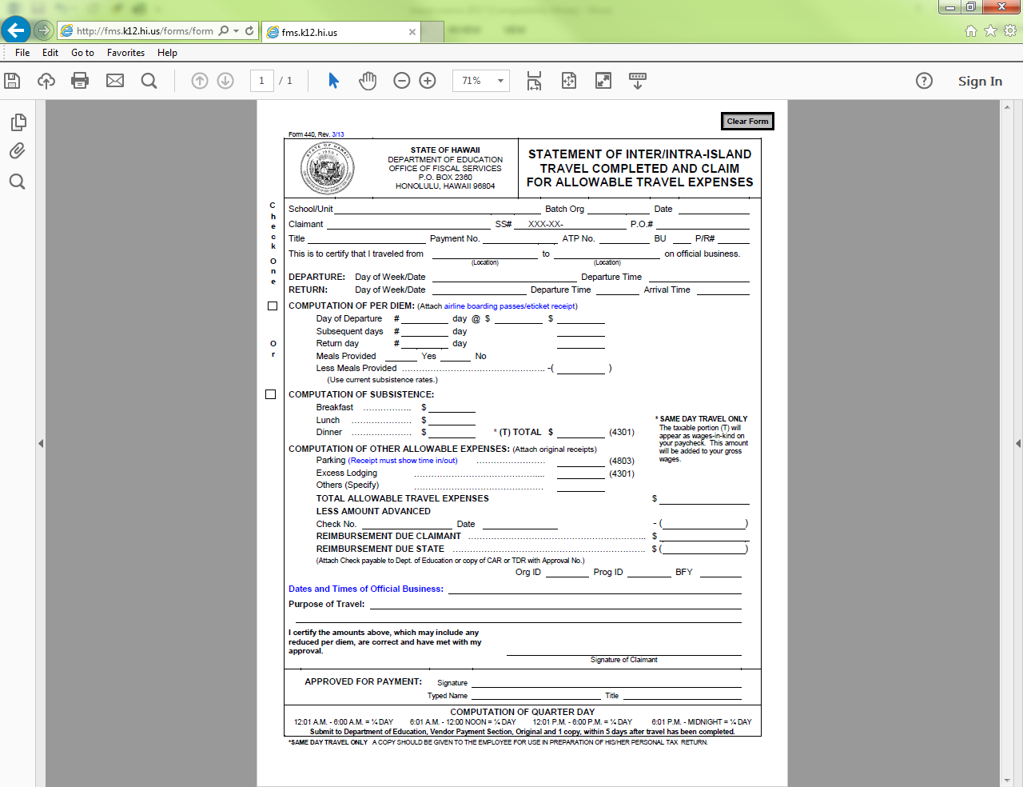
Travel reimbursement usually take 3-4 weeks to process !

Slide 24
Award Amount
Amount of funds awarded are based on:
  Per Pupil Rate
  Calculated on a formula basis based on the number of students in both Public school enrollment and Private school participant enrollment

Slide 25
Availability of Funds
Funds are available from October 1, 2018 through September 30, 2019
  NEW: Section 1117(a)(4)(B) of ESSA – funds allocated…shall be obligated in the fiscal year for which the funds are received by the agency
Deadline to submit Request for Funds (PS1) must be submitted no later than September 1 of the year that the funds expire (travel requests must be submitted by August 15).

Slide 26
Questions?
Contact Information:
Email: title2privateschool@notes.k12.hi.us
Telephone: 808-441-8499
Website: eq.k12.hi.us (Private School Equitable Participation)

